Slide 1
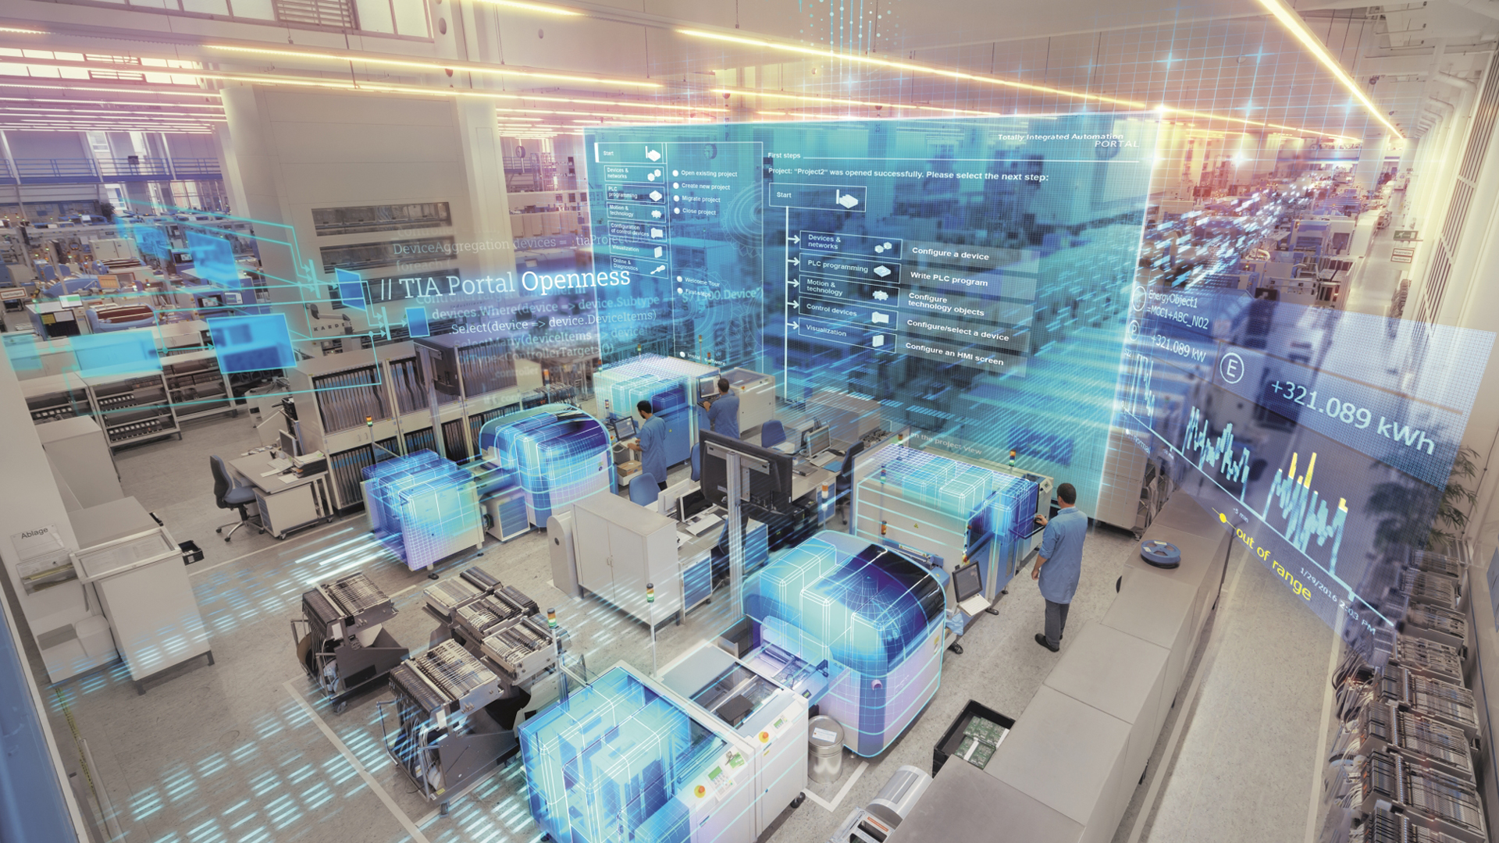
TIA Portal Cloud Connector with Reverse Proxy
June 2018
siemens.com/tia-portal
Restricted © Siemens Ltd., China 2018

Slide 2
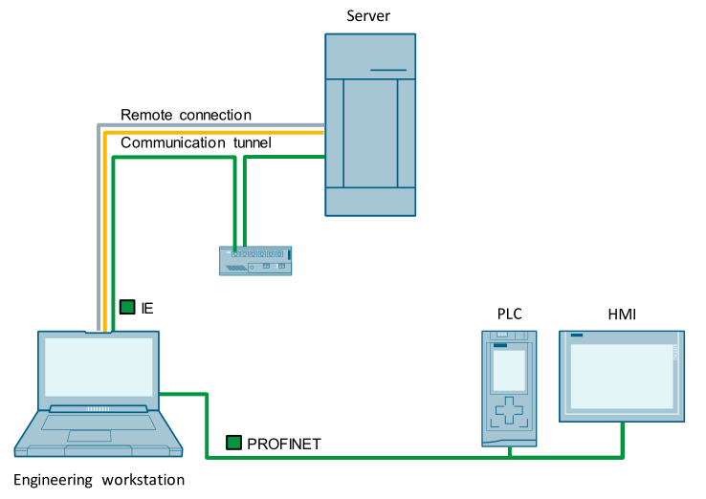
SIOS Application Example: Working with Cloud Connector
https://support.industry.siemens.com/cs/us/en/view/109747305
Comments:
A fixed internet IP is required for User Device.
Remote Device can be cloud VM or engineer’s PG/PC
Cloud VM can be used for maintaining different versions of TIA Portal. And a remote desktop operation is required.
User Device TIA portal license can be shared to Remote Device.
Remote Device with TIA Portal full installation in a VM.
IP: 202.78.12.16
Port: 3389
Disadvantages:
Normally it is very hard to find a fixed internet IP or port mapping workaround for on-site User Device. Most common use case is to use mobile phone WiFi hotspot to access the internet from on-site, which is NAT for many times.
IP: 202.78.12.18
Port: 9022
User Device with TIA Portal Cloud Connector

Slide 3
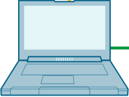
New Application Example: Cloud Connector with Reverse Proxy
Remote Device
Engineer’s PC/PG with full TIA Portal installation
VM server with fixed IP, installed with Reverse Proxy “FRP”
IP: 202.78.12.16
Port: 9022
Comments:
IP: 192.168.4.12
A fixed internet IP is required VM Server.
Reverse Proxy “FRP” is installed on VM Server.
No fixed internet IP is required for either User Device nor Remote Device.
FRP
Server
Advantages:
On-site User Device can use mobile phone WiFi hotspot to get access to the Internet.
Remote Device can use any method to get access to Internet.
Customer can obtain an “always-on” connection to site.
IP: 192.168.0.100
Port: 9022
FRP
Client
“FRP”: Open Source Reverse Proxy for Windows/Linux/FreeBSD/MacOS
FRP is a fast reverse proxy to help you expose a local server behind a NAT or firewall to the internet. Now, it supports tcp, udp, http and https protocol when requests can be forwarded by domains to backward web services.
License: Apache License 2.0 Homepage: https://github.com/fatedier/frp
User Device with TIA Portal Cloud Connector

Slide 4
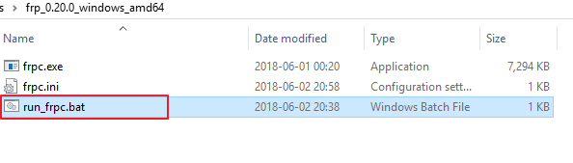
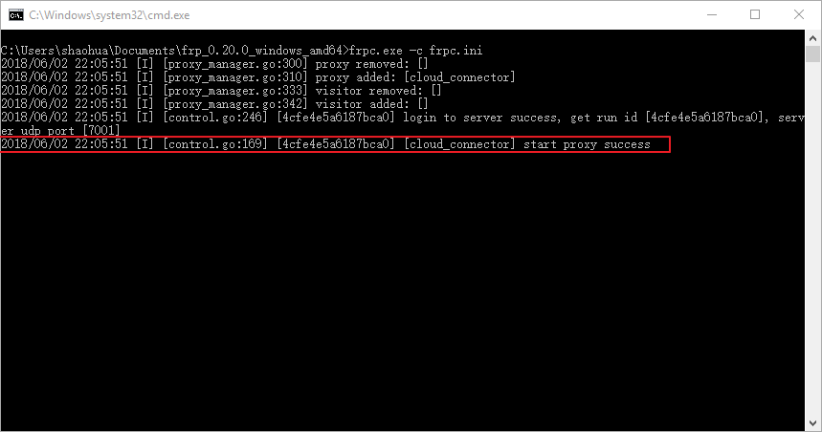
1/2 Steps on User Device Run FRP client

Slide 5
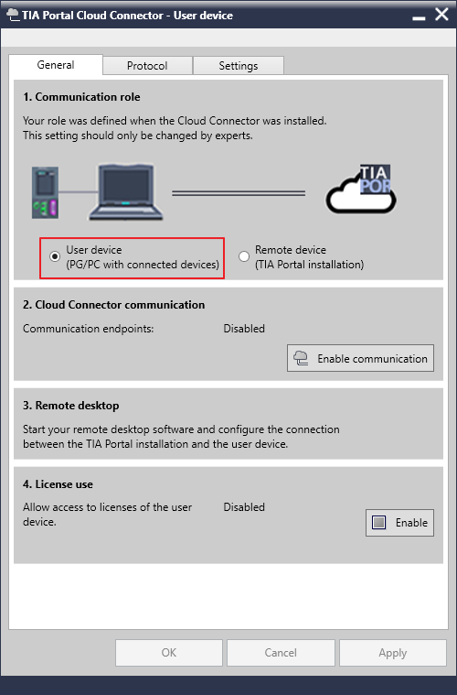
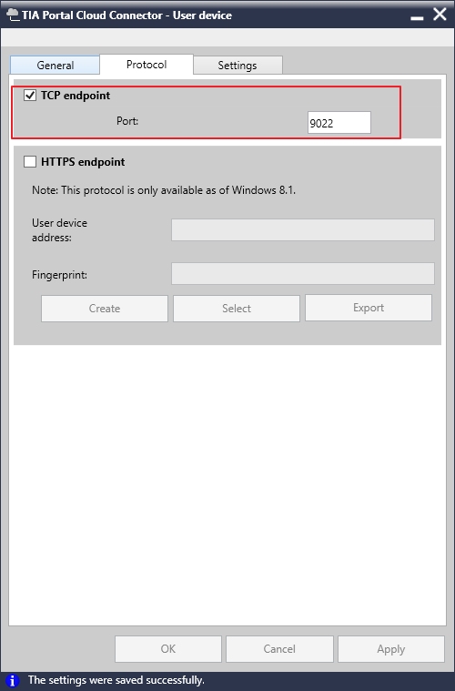
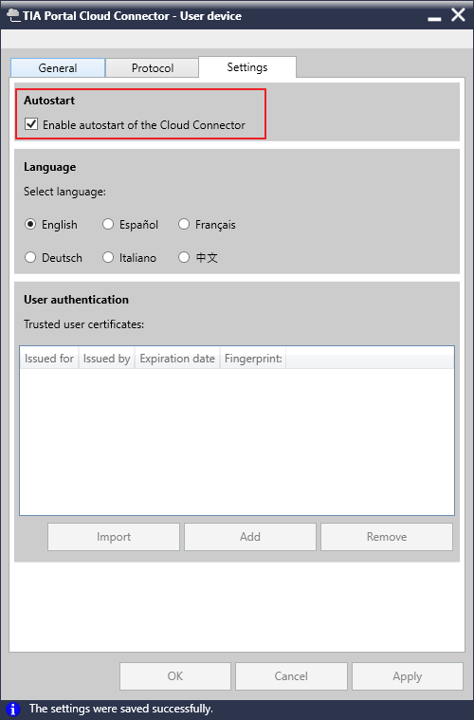
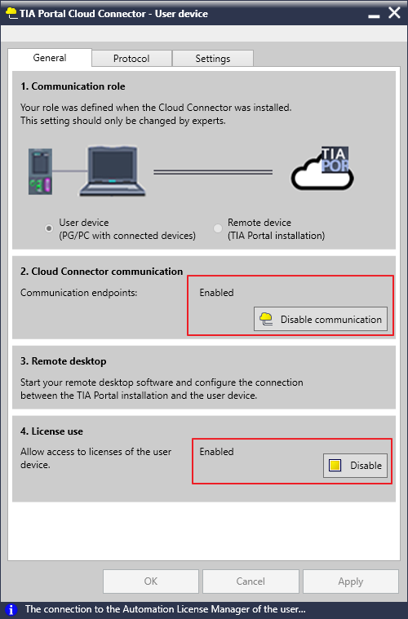
2/2 Steps on User Device Config Cloud Connecor

Slide 6
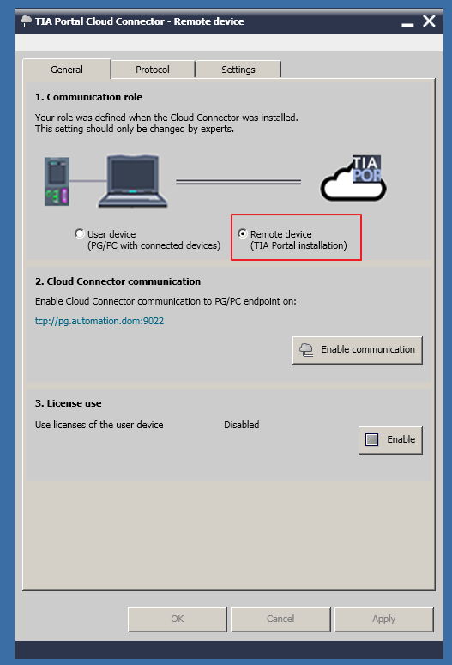
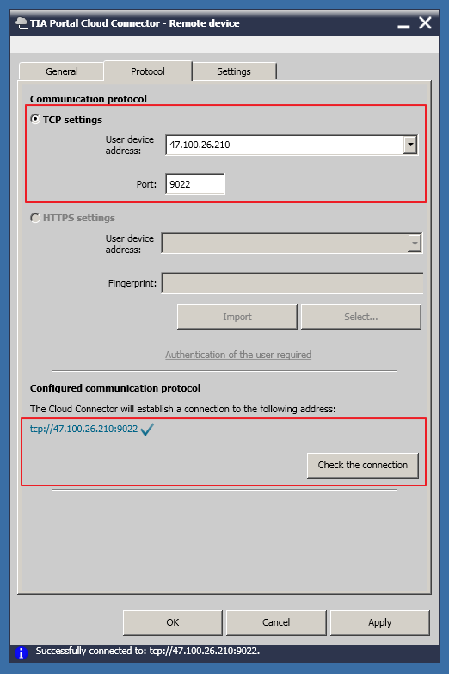
1/1 Steps on Remote Device Config Cloud Connector
Use the IP and port of the Cloud VM Server

Slide 7
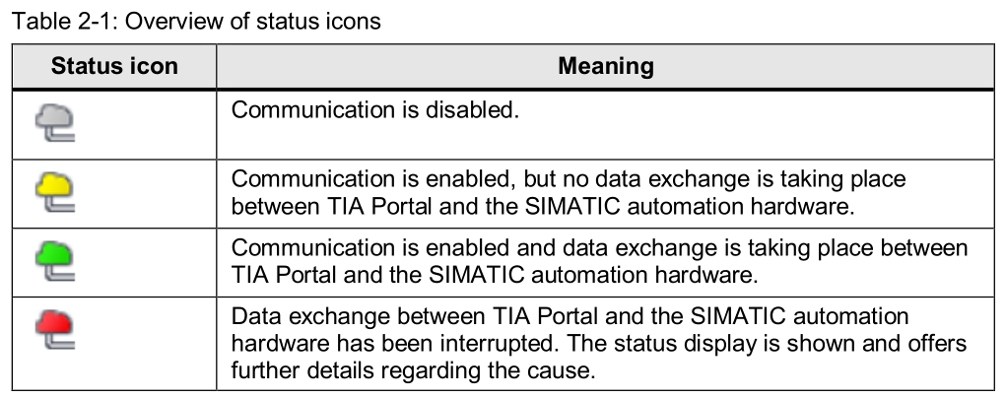
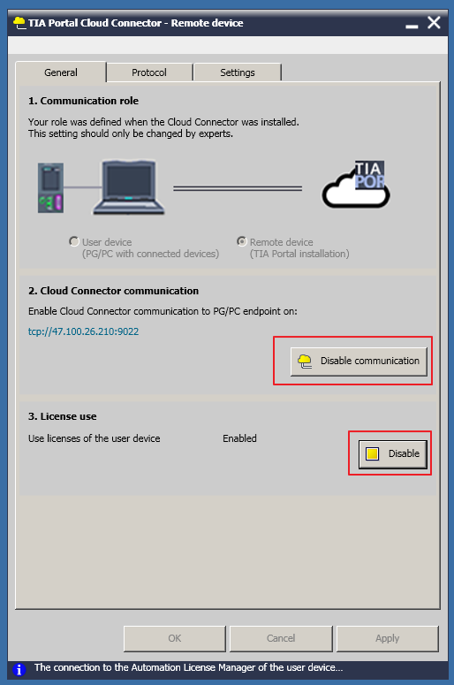
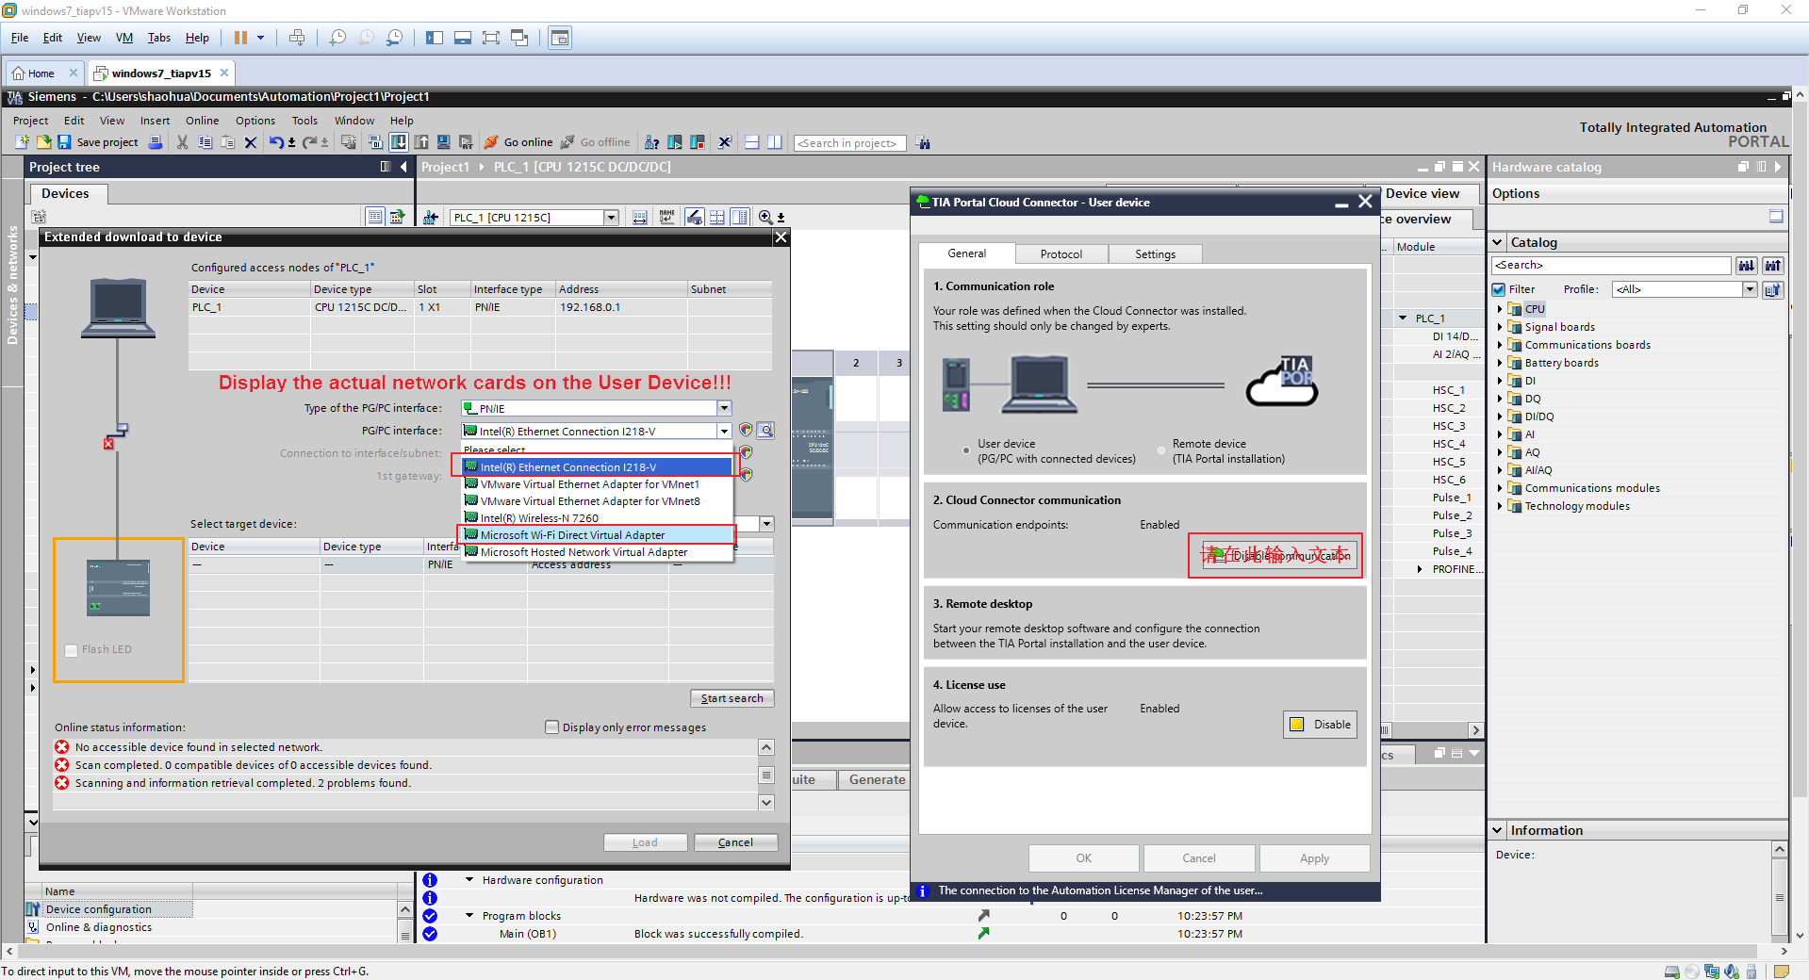
Cloud Connector + FRP Reverse Proxy Test Run
Enable Communication on Remote Device
After running the TIA Portal, the ICON changed to Green.
And the actual network cards on User Device are available for Remote Device.

Slide 8
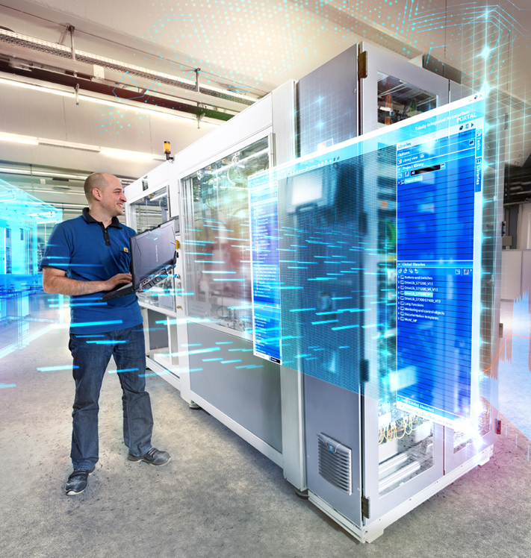
TIA Portal Cloud Connector with Reverse Proxy FRP
Ding Shao Hua
Technical Consultant
RC-CN DF FA PRM SUP
Mobile: +86 189 1757 6981
E-Mail: shaohua.ding@siemens.com
www.siemens.com/tia-portal

